Slide 1



WELCOME TO
GAY STATION
Internet cafe number 1 in Thu Duc district
G - Game Management
A - Analytics
Y - Yield Optimization
1

Slide 2



GAY STATION
MEET OUR TEAM
Pham Tuan
Hoai Viet
Thanh Trung
Khanh Tuan
Nhat Thai
Huynh Thang
2

Slide 3
INTRODUCTIOn
Literature Review
Method & Solution
Result conclusion
Video Demo
QQA
3

Slide 4


OUR SPECIALITY
WHAT IS THE PRODUCT THAT WE ARE DEVELOPING?
GAY STATION
A Cyber Gaming (CG) platform tailored for the growing eSports market in Vietnam.
Provides an immersive, high-performance gaming experience, designed to overcome limitations of low-spec computers and enhance operational efficiency.
4

Slide 5
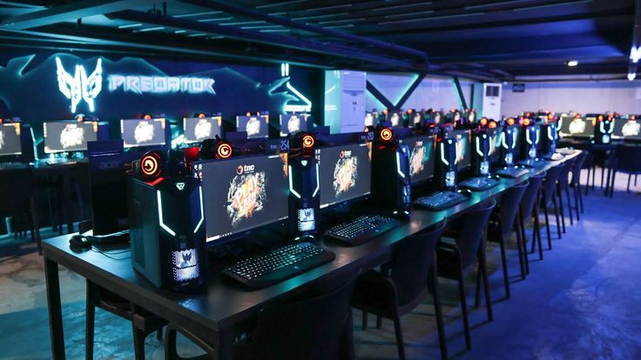
WHY WE CHOOSE TO DEVELOP THIS PRODUCT?
GAY STATION
5

Slide 6

WHAT IS THE PRODUCT THAT WE ARE DEVELOPING?
IN REALITY
In reality
In Vietnam, 44.9% of eSports players use PCs, reflecting the strong popularity of computer gaming. This is driven by the immersive experience PCs offer and the culture of gaming in internet cafes.
6

Slide 7
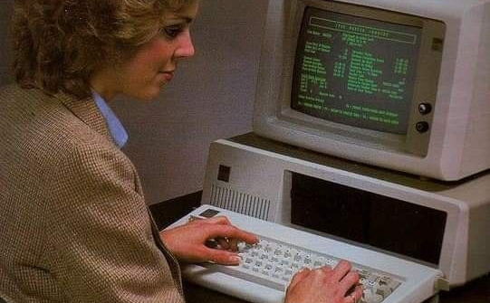

OUR PECIALITY
Challenges
GAY STATION
Current internet cafes are still using current error management systems, which are difficult to use.
Not only do we need to pay much attention to the quality of hardware and software, we must also ensure support services such as space and customer service.
7

Slide 8


Internet cafe management products.
gay station
THE INTERFACE HAS A MINIMALIST STYLE.
OUTSTANDING CUSTOMER SERVICE.
EASY MANAGEMENT PLATFORM.
8

Slide 9






Main target
Identify functional and non-functional requirements of the system.
Ensure user requirements, system behavior, and technical specifications are clear.
Provide detailed design for Cyber ​​Gaming (CG) system development and deployment.
Ensure a unified understanding of scope and objectives across all stakeholders.
Minimize the risk of misunderstandings and ensure software aligns with business requirements.
9

Slide 10

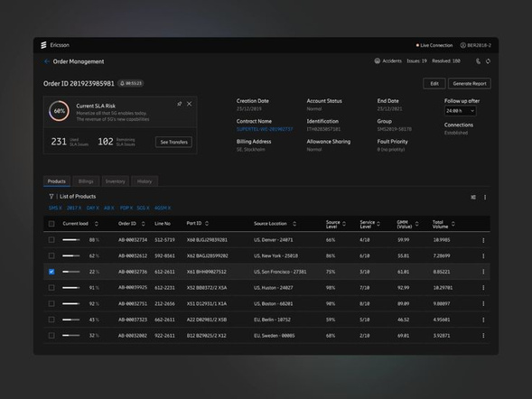

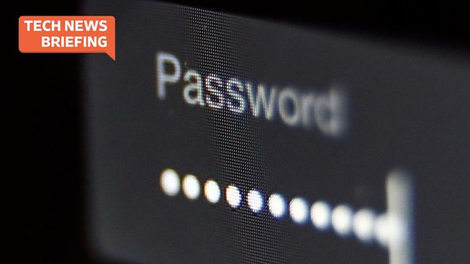
main scope
Smooth checkout process
Process payments, manage invoices and generate receipts, support multiple payment methods
Security
Manage administrator and user information database, ensure limited access rights and easily check, add, delete accounts.
Order Management
The system supports order processing, product management and menu customization, ensuring fast and accurate ordering and tracking.
Forgot Password Mechanism
Provides a secure and easy-to-use method for users to recover their passwords
10

Slide 11
Literature Review
Introduction
Method & Solution
Result conclusion
Video Demo
QQA

Slide 12

overview
In big cyber gaming, net management software is becoming an important trend. We decided to develop a management system that enhances player experience and optimizes the workflow for staff.
12

Slide 13
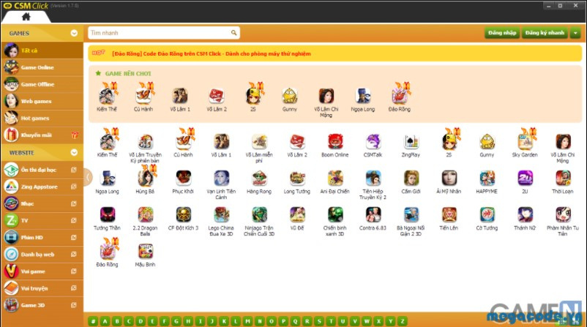
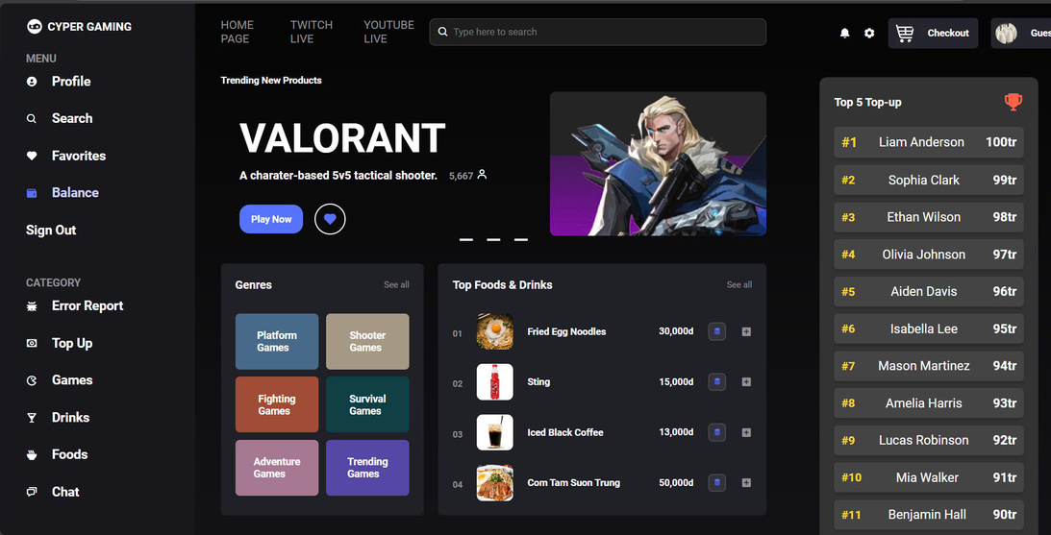
CUSTOMER INTERFACE
GAY STATION
Traditional software has a rather old interface and is not optimized for users, especially for beginners.
Our products have a friendly interface, are easy to use, optimized for all customers, and can be customized according to the needs of each internet shop.
13

Slide 14
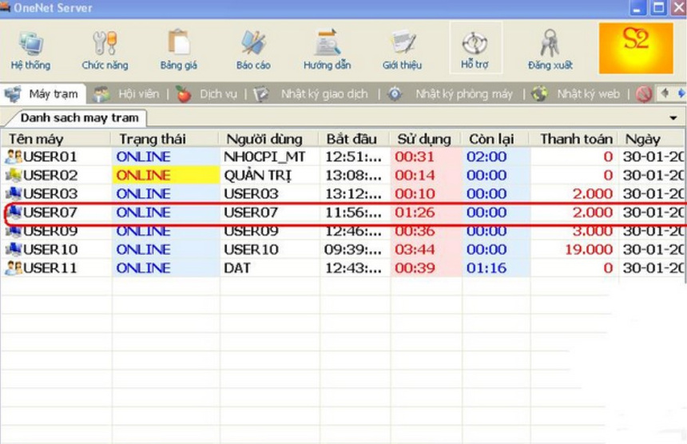
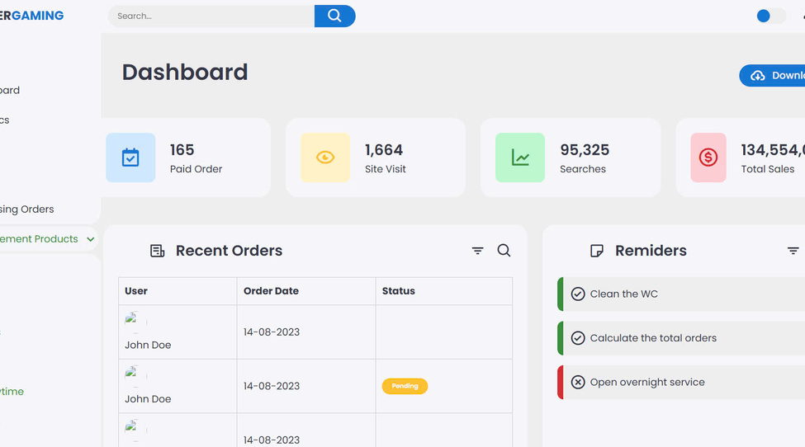
Features and Integrations
GAY STATION
Traditional software only has basic features like game time management, billing, and monitoring.
Integrates many smart features such as user data analysis, customer order management, revenue management, service staff reminders, customer file analysis.
14

Slide 15
Introduction
Literature Review
Method,Solution
Result conclusion
Video Demo
QQA
15

Slide 16




method
We apply Agile methodology in the product development process, helping to continuously adjust and improve the product based on actual feedback from users, ensuring high performance and efficiency in developing new features. .
NODE.JS
CSS
HTML
SQL
16

Slide 17

User Authentication and Access Control
This component of the online gaming system focuses on account authentication and related functions.
17

Slide 18


User Authentication and Access Control
Check if username contain “Admin”
<<include>>
Register
Admin
User
Login
<<include>>
Verify Information
Exit
18

Slide 19

Items Management
The "Items Management" module within the Cyber ​​Gaming platform focuses on overseeing and updating information for the items featured on the menu.
19

Slide 20
Item maganagement
Check amount of foods, dinks,card
Admin
User
ADD new foods, drinks, card, discount
Delete existing foods, drinks, cards,...
Confirm the orders
20

Slide 21
Manage Account
The "MANAGE ACCOUNT" section within the cyber gaming system is designed to handle user account administration and ensure the security and accuracy of user data.
21

Slide 22
Manage Account
Check account profile
<<include>>
Verify information of user
User
Admin
Add account
<<include>>
Check if that account exist
Delete account
<<include>>
Find Account
Edit Account
22

Slide 23

Order Processing
Within the Cyber Gaming system, the Manage Order Information section is crucial for monitoring and streamlining all order-related activities.
23

Slide 24
Order Processing
<<include>>
Choose food, drink, card
System verify order
<<Extend>>
User
Check order
Choose quantity of service
<<include>>
<<include>>
Admin
Make Payment
Edit options
Confirm order
24

Slide 25

Manage Computer
The Manage Computer module within the cyber gaming platform is designed to oversee and organize all computer-related information.
25

Slide 26
Manage Computer
Find computer
Admin
Shut down computer
Check status of computer
Check specification of computer
26

Slide 27
Introduction
Literature Review
Method,Solution
Result conclusion
Video Demo
QQA
27

Slide 28

functional requirement
28

Slide 29
USER AUTHENTICATION AND ACCESS CONTROL
ITEMS MANAGEMENT
Administrator
Administrator
Unlimited privileges to utilize every available system feature.
Can track all the items and easily to add/delete items if needed
USER
USER
Access to order management and table-related functionalities.
Friendly UI so that users can find any things they want easy and fast
29

Slide 30




MENU MANAGEMENT
BILLING AND PAYMENT
Menu Categorization
ACCURACY
Menu items are grouped logically (e.g., foods, drinks, cart) for easy navigation and ordering.
Generation of accurate bills.
OTHER
PRINTING
Create New Items, Remove Old Items, Adjust Pricing of Items, Upload Images of Items.
Integration with payment processors and receipt printing.
30

Slide 31



ORDER PROCESSING
FORGOT PASSWORD MECHANISM
Multiple Items in Order
Secure Password Reset
supports adding multiple items per order, including different quantities and various types (e.g., food, drink, card).
Password reset is based on Citizen Identification Card for security.
OTHER
Identity Verification
Synchronize orders and evaluate completed orders.
Friendly UI so that users can find any things they want easy and fast
31

Slide 32
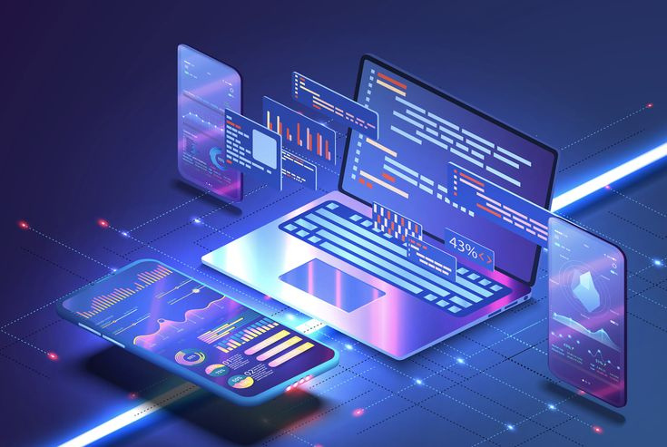
non-functional requirement
32

Slide 33

USABILITY
COMPATIBILITY
User-Friendly Interface
Cross-Browser Compatibility
Complete the creation of a user-friendly and easy-to-use interface.
The system function consistently across all major web browsers : Chrome, Firefox, Safari, and Edge
33

Slide 34
Class diagram
34

Slide 35
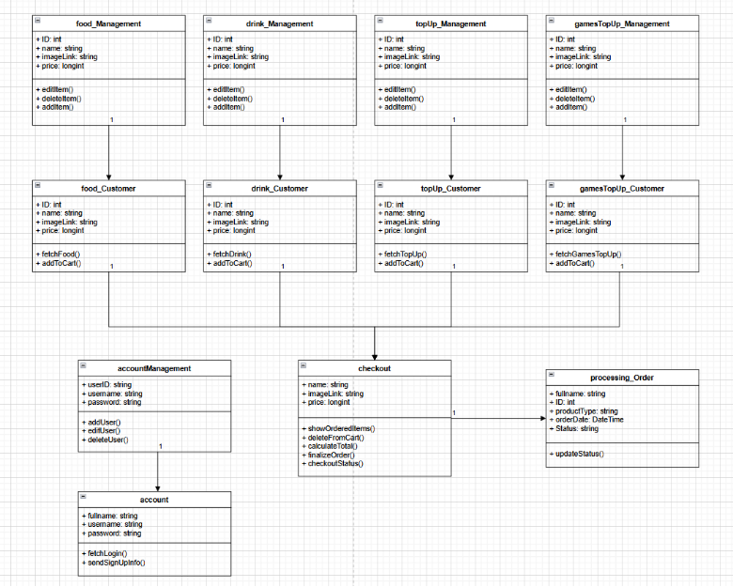
35

Slide 36
entiry relationship diagram
36

Slide 37
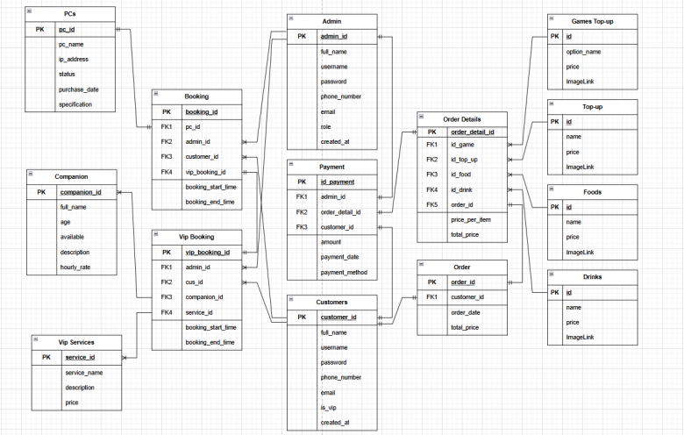
37

Slide 38
conclusion
38

Slide 39



GAY STATION
COMPARED TO THE SET TARGET, WE HAVE.
User-friendly interface for both admin and users.
Admin can manage the system easily without technical knowledge.
Clear access rights, allowing users to control their accounts without affecting the system.
Organized food and beverage storage, easily updated with trendy items.
Diverse payment options, with revenue tracking via statistical algorithms, admin-only access.
39

Slide 40

GAY STATION
DISADVANTAGE
Some basic features are missing, which may affect the overall user experience.
01
User information lacks sufficient security, making it vulnerable to breaches.
02
Some functions are manual, and due to fast-changing trends, updates may become complex and challenging.
03
40

Slide 41

Introduction
Literature Review
Method,Solution
Result conclusion
Video Demo
QQA
41

Slide 42
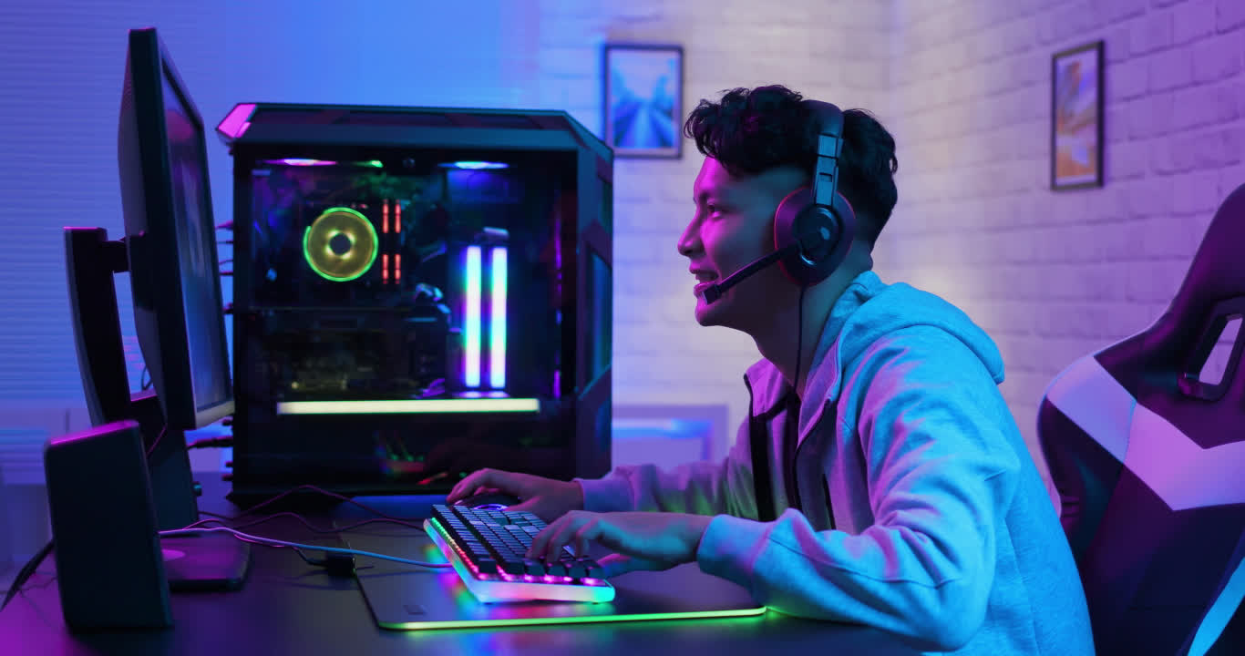
THANK YOU
FOR WATCHING US
42

Slide 43

GAY STATION
Q&A
SOME QUESTION FOR USS ?
03
43

Slide 44



SOURCE
Pinterest
image source
Pixabay
Canva
44

